Slide 1
Paper Presentation on The Hadoop Distributed File System Konstantin Shvachko, Hairong Kuang, Sanjay Radia, Robert Chansler Yahoo!
Team No: 03
Name: Iffat Ara Jui Id: 23166010
ST : Ehsanur Rahman Rhythm
RA: Sania Azhmee Bhuiyan
1

Slide 2
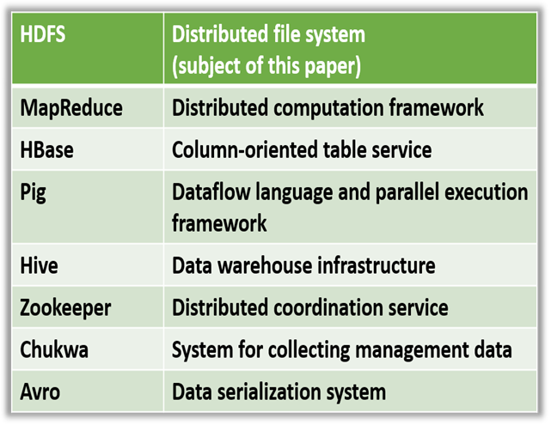
Introduction
- A data storage system used by Hadoop
applications.
- It is a distributed file system and a framework that can analysis and transform very large data
sets using the MapReduce paradigm.
- Can partition the data and can perform computation across many(thousands)of hosts, and execute application computations in parallel
close to their data.
- It is the file system component of Hadoop.
- In this paper the authors described the architecture of HDFS and report on the experience using HDFS to manage 25 petabytes of enterprise data at Yahoo.Distributed
Table 1: Hadoop Project Component
2

Slide 3
Features
1. HDFS provides one of the most reliable filesystems. 2. It has a unique design that provides storage for extremely large files with streaming data access pattern. 3. It is designed on principle of write-once and read-many-times. Once data is written large portions of dataset can be processed any number times.
4. It runs on commodity hardware: hardware that is inexpensive and easily available in the market.
3

Slide 4
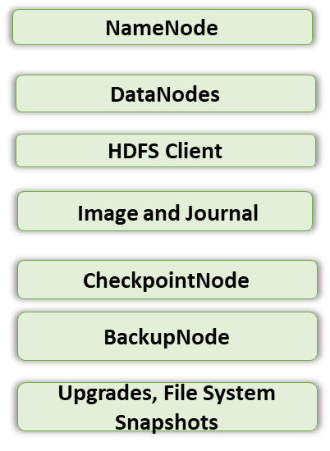

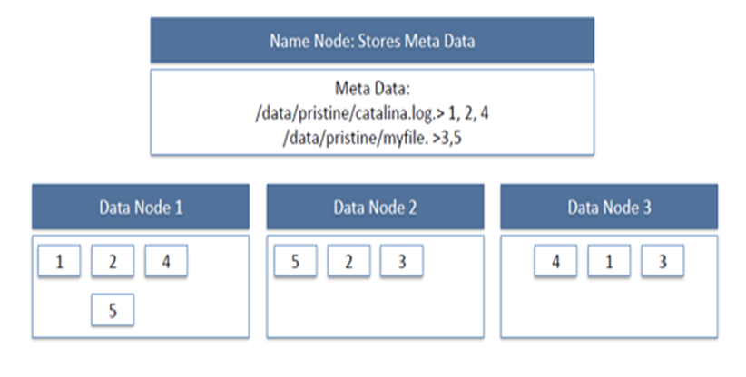
Architecture of HDFS
- NameNode Manages the file system namespace.
- Regulates client’s access to files.
- It also executes file system operations such as: remaining, closing and opening files and directories.
- DataNodes perform read-write operations on the file systems, as per client request.
-They also perform operations such as block creation, deletion, and replication according to the instructions of the NameNode.
- HDFS Client is a code library that exports the HDFS file system interface. - User applications can access the file system using the HDFS client. - BackupNode is a recently introduced feature.
Figure1:HDFS DataNodes and NameNode Image
4

Slide 5

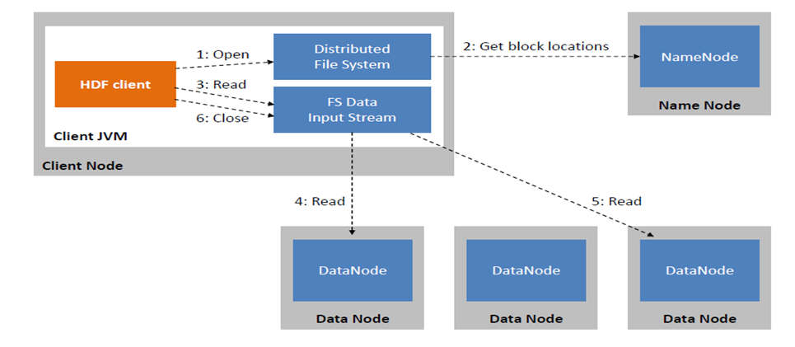

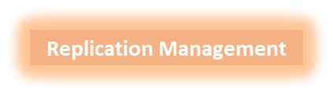
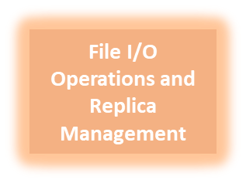


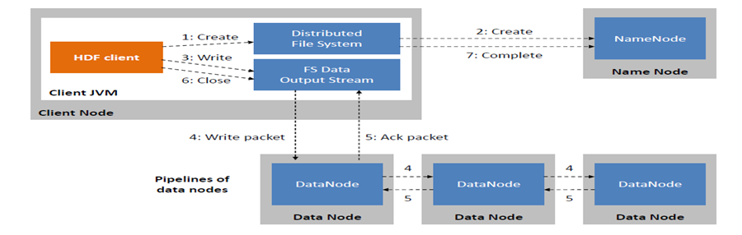
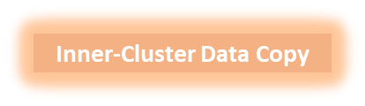
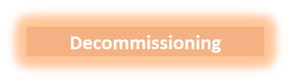
File I/O Operations and Replica Management of HDFS
HDFS Read Image:
Figure 2: HDFS Read Image
HDFS Write Image:
HDFS Write Image:
Figure3: HDFS Write Image
5

Slide 6
Future Work
1. To stop the automated failover a BackupNode has been created that receives all transactions
from the primary NameNode. 2. The authors have planned to use Zookeeper at Yahoo’s distributed consensus technology to build an automated failover solution. 3. Block IDs will be extended to prefix by the block pool identifiers. It will solve the scalability problem by allowing namespaces(and NameNodes) to share the physical storage within a cluster. 4. Authors are also planning to use application or job centric namespaces instead of cluster
centric namespaces.
6

Slide 7
References
- Apache Hadoop. http://hadoop.apache.org/ - F. P. Junqueira, B. C. Reed. “The life and times of a zookeeper,” In Proc. of the 28th ACM Symposium on Principles of Distributed Computing, Calgary, AB, Canada, August 10-12, 2009. - J. Venner, Pro Hadoop. Apress, June 22, 2009. - T. White, Hadoop: The Definitive Guide. O'Reilly Media, Yahoo! Press, June 5,
2009. - K. V. Shvachko, “HDFS Scalability: The limits to growth,” ;login:. April 2010, pp. 6-16.
7

Slide 8
Thank You
8

